Slide 1

Algorithms Program Week5:
Basic Bits Manpulation

Slide 2
Outcomes today
Understand Binary Numbers System
Understand how to convert from Binary to Decimal and viceversa
Learn Bitwise operators
Examples and cool tricks

Slide 3
What is the binary system
Numbers we normally use are called decimal numbers.
Binary numbers are basically the ones and zeros you always see associated with computers!
In decimal (Base 10) , we are allowed to use 10 numbers (0,1,2,3,4,5,6,7,8,9)
In Binary , we are allowed to use only 2 numbers (0,1)

Slide 4
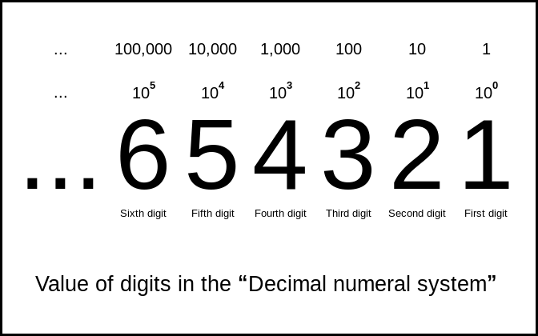
How are decimal numbers represented ?
Source of picture: https://en.wikiversity.org/wiki/Numeral_systems

Slide 5
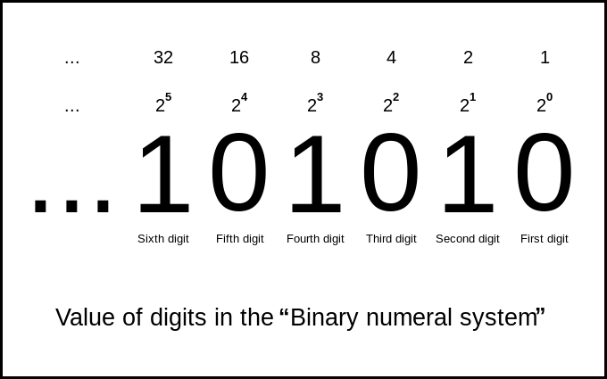
Using the same logic, we represent binary numbers
Source of picture:https://www.toppr.com/guides/maths/fractions-and-decimals/decimal-numbers/

Slide 6
We can conclude a very nice propery
We can write any number as the sum of unique powers of 2 !

Slide 7
This logic Actually holds for any base !
We can write numbers based in 3,7,11,16,…
We can choose any base we want !

Slide 8
How to transform from Decimal to binary ?

Slide 9
Decimal to binary: Easy non-programming way
Assume we want to transform x.
1
Find the greatest power of 2 less than or equal to x
2
Set the bit corresponding to it to 1
3
Subtract it from x, and repeat this process until u reach 0.
4

Slide 10
Decimal to binary: Programming way
While x != 0
Divide x by 2, and add x%2 to the solution which we will have as a string
We will implement it today !

Slide 11
Now what about the other way : binary to decimal ?
Very simple ! We know that each bit corresponds to a certain power of two!
Extract those powers and sum them up !
We will also implement this in a very cool way!

Slide 12
NOW That we know that each number has a binary representation
Why did we learn this ?
How will we use it ?

Slide 13
Integers as binary strings
We know now how to represent each integer as a sequence of bits.
In Competitions, thinking of the number as a sequence of bits instead of its original value gives us many useful properties and capabilities !
First, you should know that are operators in C++ that can be applied on the integers, but they only have a meaning when we think of numbers as binary strings!

Slide 14
Bitwise operations
AND ( & )
OR ( | ) :
XOR ( ^ )
NOT ( ~ )
Left Shift ( << )
Right Shift ( >> )

Slide 15
AND bitwise operator
X | Y | X & Y
0 | 0 | 0
1 | 0 | 0
0 | 1 | 0
1 | 1 | 1
Assume X and Y each is 1 bit (either 0 or 1)
(X & Y) = 1 if (X = 1 and Y = 1)
(X & Y) = 0 otherwise

Slide 16
OR bitwise operator
X | Y | X | Y
0 | 0 | 0
1 | 0 | 1
0 | 1 | 1
1 | 1 | 1
Assume X and Y each is 1 bit (either 0 or 1)
(X | Y) = 1 if (X = 1 or Y = 1)
(X | Y) = 0 otherwise

Slide 17
XOR bitwise operator
X | Y | X ^ Y
0 | 0 | 0
1 | 0 | 1
0 | 1 | 1
1 | 1 | 0
Assume X and Y each is 1 bit (either 0 or 1)
(X ^ Y) = 1 if (X != Y)
(X ^ Y) = 0 otherwise

Slide 18
NOT bitwise operator
It simply flips the bits of a numer
If X = 1 -> ~X = 0
If X = 0 -> ~X = 1

Slide 19

LEFT shift BITwise Operation
This operator applies to a string of bits
It shifts all bits to the left and fills the empty places with zero
(X << y ) : X is shifted to the left y places
This is equivalent to multiplying a number by $2^{y}$
Example :
X = 100101
X << 2 = 10010100

Slide 20

RIGHT shift BITwise Operation
This operator applies to a string of bits
It shifts all bits to the left and fills the empty places with zero
(X >> y ) : X is shifted to the right y places
This is equivalent to multiplying a number by $2^{y}$
Example :
X = 100101
X >> 2 = 001001

Slide 21

NOW time for some coding !

